Slide 1
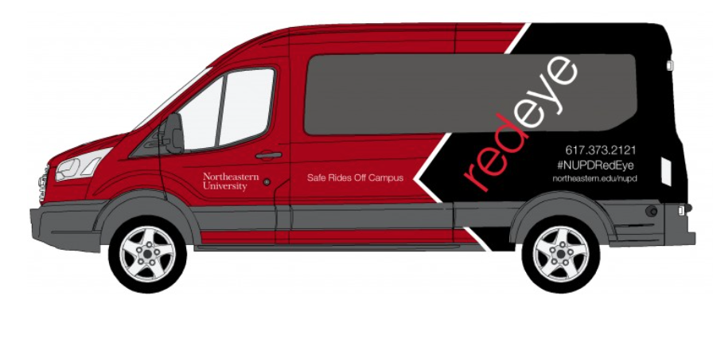

NU RedEye Connect
10 August 2016

Slide 2


BUSINESS CASE TEAM
Jahnvi
Developer
Vaishak
Quality Analyst
Vandana
Business Analyst
Shikha
Developer
Executive Sponsor
Thiyagarajan
Project Manager
Guided by Professor Gail Raynus

Slide 3

PROBLEM STATEMENT
What ?
Route computations for multi-destination drop is not efficient and time is wasted for collecting data from students manually and this interrupts the shuttle frequency with limited vehicles.
Who ?
Drivers find difficulty in computing the best route for multiple destinations.
Students unable to track the shuttle and experience delay in routes.
Administrators (NUPD) spending manual effort to approve and document on trip details.

Slide 4


Assumptions and Dependencies
Stakeholders must have smart phone.
Active internet connection.
Drivers and other stakeholders able to use the app with minimal/no training.
Funding is available for purchasing hardware/software for the new application.
NUPD and NEU management will provide necessary support for successful projects implementation.
NEU cloud space for application hosting and data storage.

Slide 5
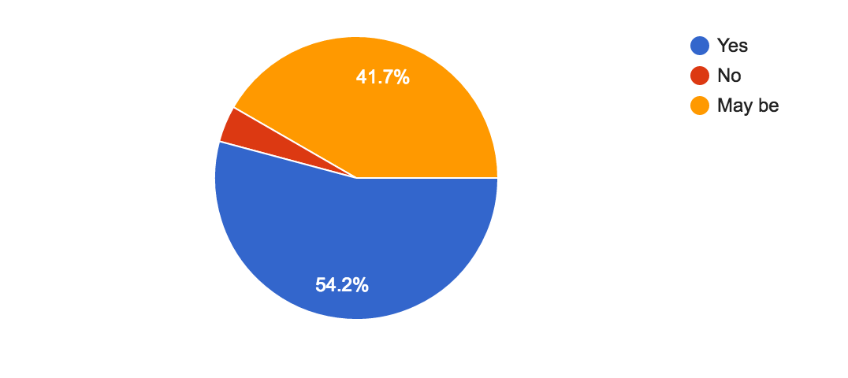
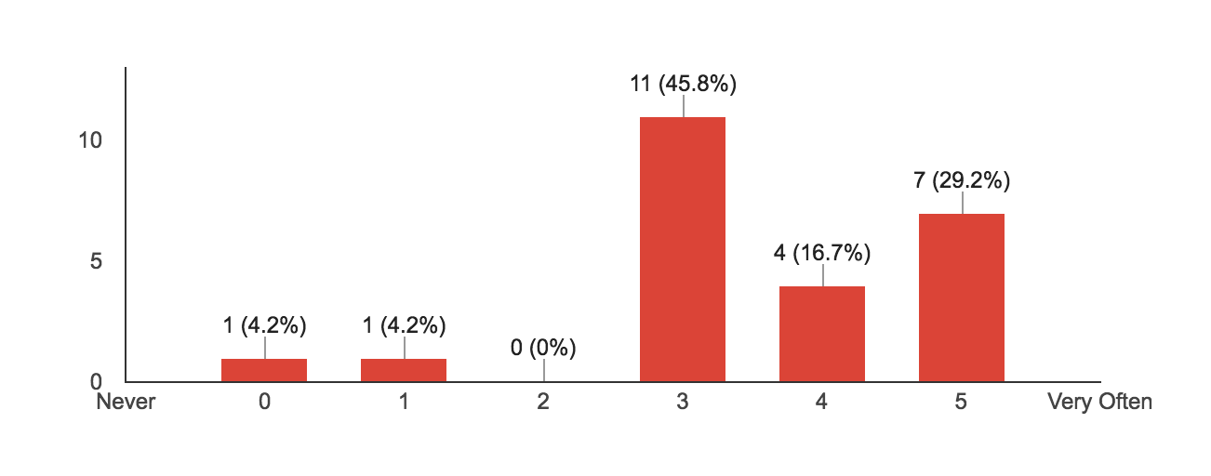
Requirements from stakeholders
Surveys
Interviews
Meetups for feature ideas
Project team brainstorming
Is RedEye route longer than usual ?
Late Drop – Rate

Slide 6

BUSINESS REQUIREMENTS
Able to secure data storage for all driver and student information.
Must be capable to track the frequency and shuttle routes.
Must have the ability to monitor and check driver’s schedule.
Must have the ability to query, give suggestions and feedback regarding shuttle services.
To provide functionality for collection, storage and retrieval of student information.

Slide 7

USER & FUNCTIONAL REQUIREMENTS
Access to Student Database
User shall have the ability to access Northeastern University’s student database.
User shall have read-only access to Northeastern University’s Student database with respect to address and immediate contact information alone.
Outage Notice
User shall have the ability to publish notices on outages as and when required.
User shall push notifications on unavailability or additional services that will show up as “Alerts”.
Processing Requests
User shall have the ability to process incoming requests
User shall be able to accept/reject incoming requests.
Track Vehicles
User shall have the ability to track the shuttle vehicles.
User shall be able to track available vehicles offering shuttle services on Map.
User shall get customized alerts based on what is being tracked.

Slide 8


USER & FUNCTIONAL REQUIREMENTS
Route Optimization:
User shall be able to select the fastest route amongst the list of available routes.
User shall be notified of any route disruption.
User shall be notified of the estimated time of arrival at each destination.
SOS:
User shall have the ability to call for immediate help and support.
User shall have one-click “call-for-help” feature for any roadside assistance.
Registration:
User shall be able to register, create profile and login to the application.
NUID shall be validated against those registered with the university and NUPD.
Navigation:
User shall track real time movement of RedEye shuttle.
User’s location shall be picked up from location on the mobile device.
Account Management:
User shall have the ability to update/reset login and personal information
User shall be able to reset login credentials..

Slide 9

NON-FUNCTIONAL REQUIREMENTS
Availability:
The system shall be available for the students to use between 5:45 PM and 7:00 AM every day, 365 days a year.
The system shall be available for the NUPD officials and the drivers to use all day, 365 days a year.
Efficiency:
The system shall notify the updated request status parameters to the users within 60 seconds of the change.
The system shall fetch new requests and notify the on-duty NUPD officials every 15 seconds.
Reliability:
The system shall be able to carry forward the approved requests to for the next shuttle and notify the students about it.
The system shall include real-time location updates, to notify the students, about the assigned shuttle.
Survival:
The system shall identify the internet connection issues to work efficiently and accurately.
The system shall notify the user about the internet connection issues, if any.
Usable:
The system shall guide the first-time users step-by-step about all the features.
Free step-by-step guide shall be available as an in-app feature.
Interoperable:
The system shall be accessible from the mobile devices as well as from the web browsers.

Slide 10


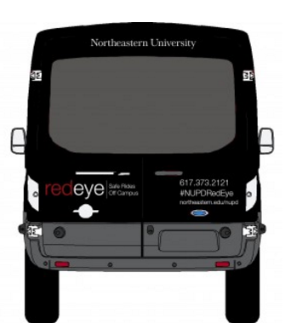



SOLUTION
The RedEye shuttle service application project will provide an all new common application interface for operating and managing the shuttle service.
It will be done by determining and selecting a technology product which not only is robust for our existing system but also allows for growth for the next 15 years.
Helps to collaborate the students, drivers and NUPD and make northeastern a more safe environment for students.
Students
RedEye App
Drivers/NUPD

Slide 11

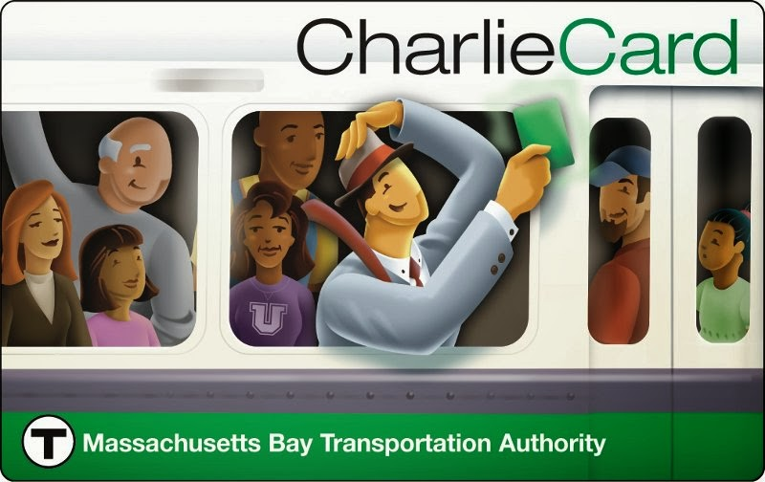
Alternative Analysis
Vanpool/Carpool
Significantly higher cost
Many students don’t have car so they might not get their desired stops and locations
MBTA Bus service
There are no night time bus services when students need it most
Unsafe as it doesn’t provide door to door services

Slide 12

PROJECT DOCUMENTS
BUSINESS CASE
USE CASE
ACTIVITY DIAGRAMS
PROCESS FLOW DIAGRAM
REQUIREMENTS DOCUMENT
WIRE SKETCH
UI PROTOTYPE DOCUMENT - FLOW
RedEye

Slide 13


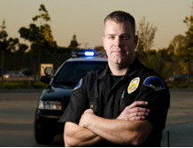
RedEye - Personas
Goals Needs
1. To safely reach home. 1. A student friendly mobile application
for shuttle services.
2. Efficiently utilize the time wasted on 2. A viable option to track shuttles.
anticipating the arrival of shuttles. 3. Feature to get quick help during emergency.
Goals Needs
1.Timely and safe transportation of 1. A tool for route computation.
students to their respective destinations.
2.Efficient and effective route selection. 2. Systematic handling of emergencies.
3.Quick resort to help in case of emergencies.
Goals Needs
Efficient and effective usage of shuttle services. 1. A collaborative web and mobile application.
Facilitate ease of use of shuttle services. 2. Extensive monitoring/ tracking.
Maximize safety of students. 3. Wide options for safer travel for students.
Provide drivers with an integrated system 4. Possible derived analytics.
for better routes and time efficiency and
hassle-free operations.

Slide 14
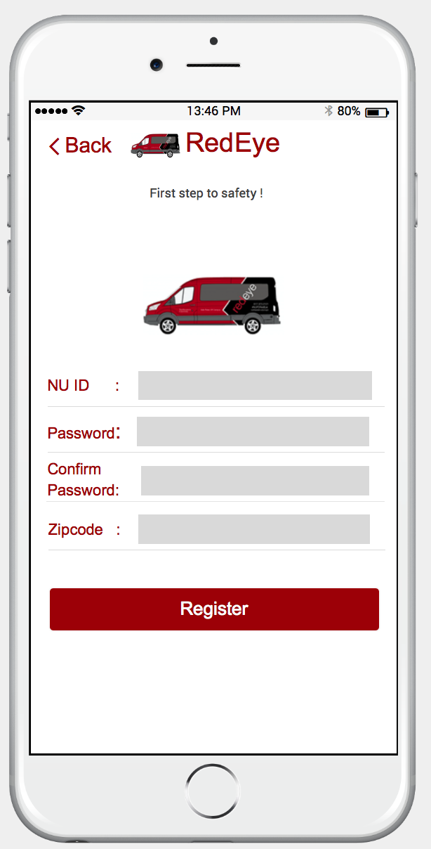
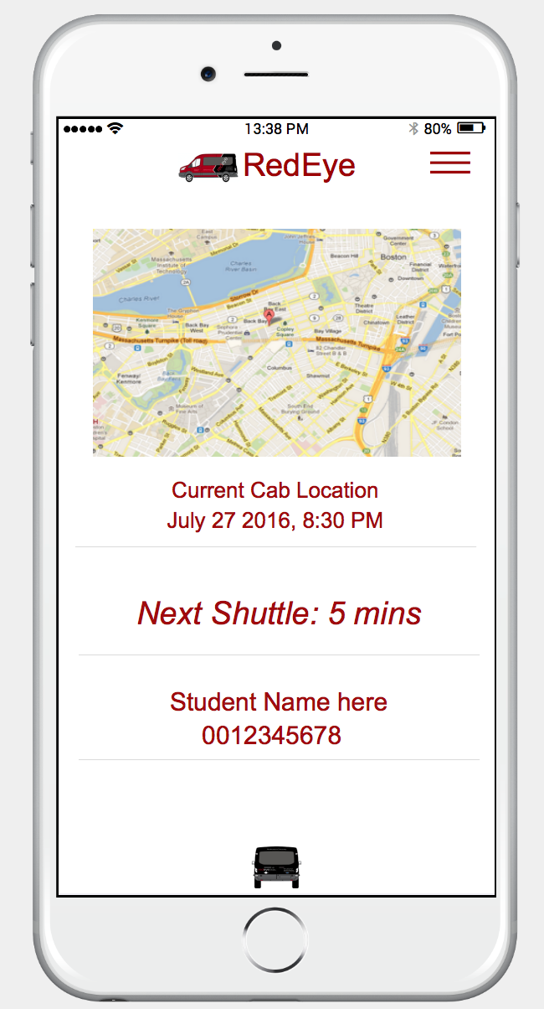
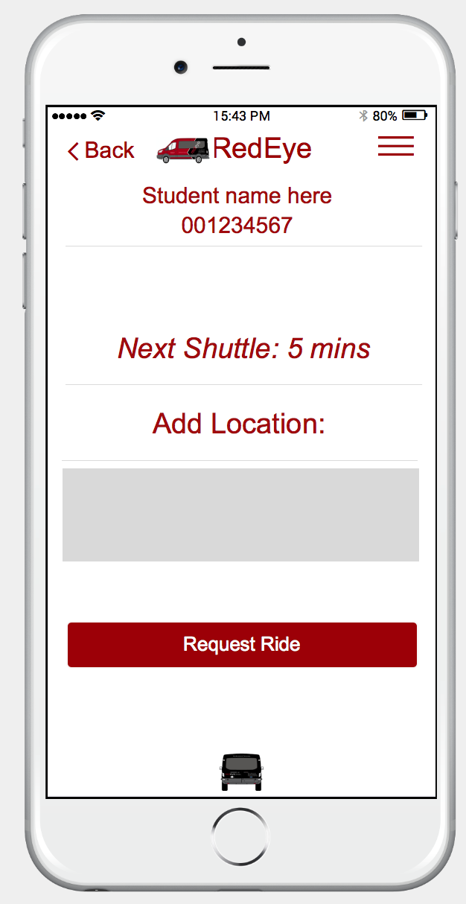
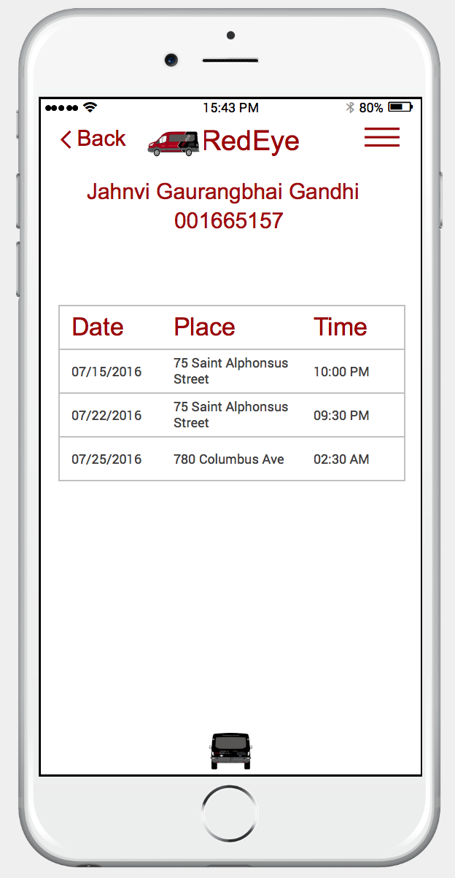
UI - STUDENT

Slide 15
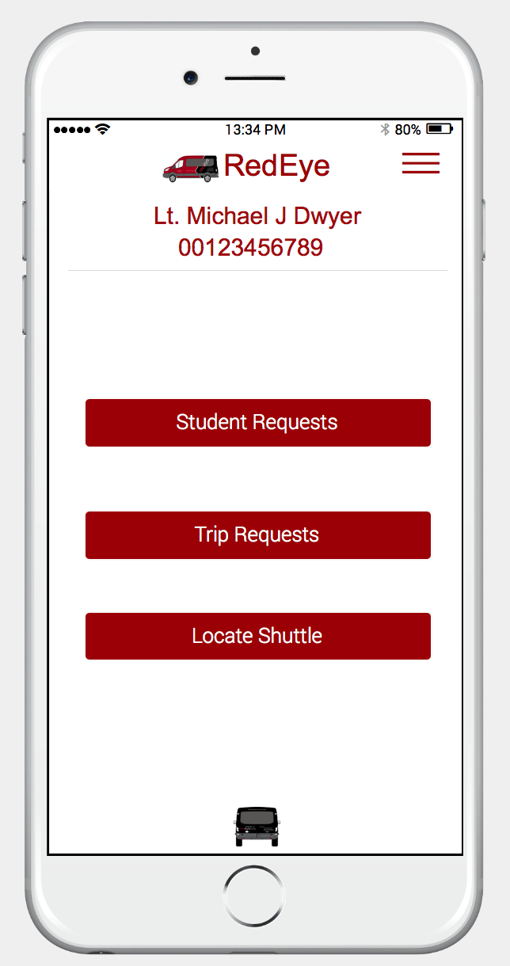
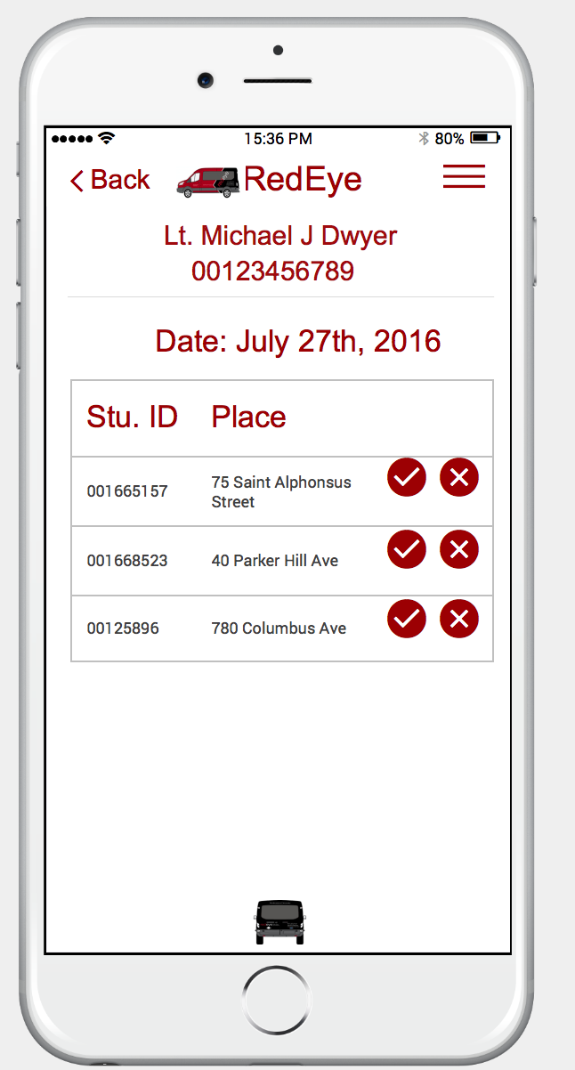
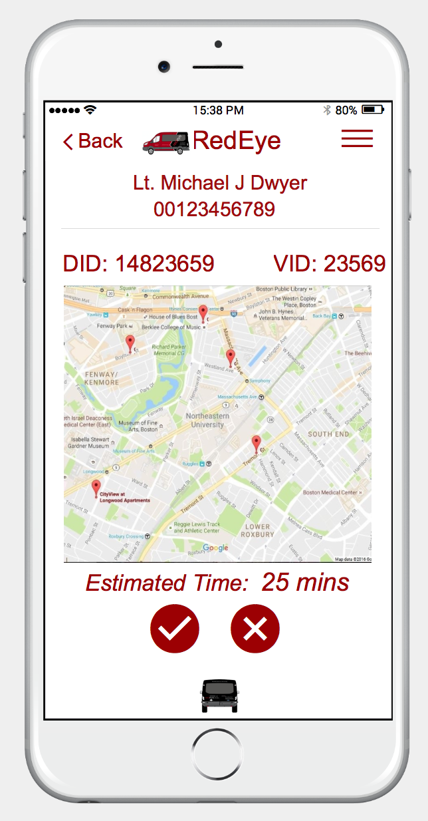
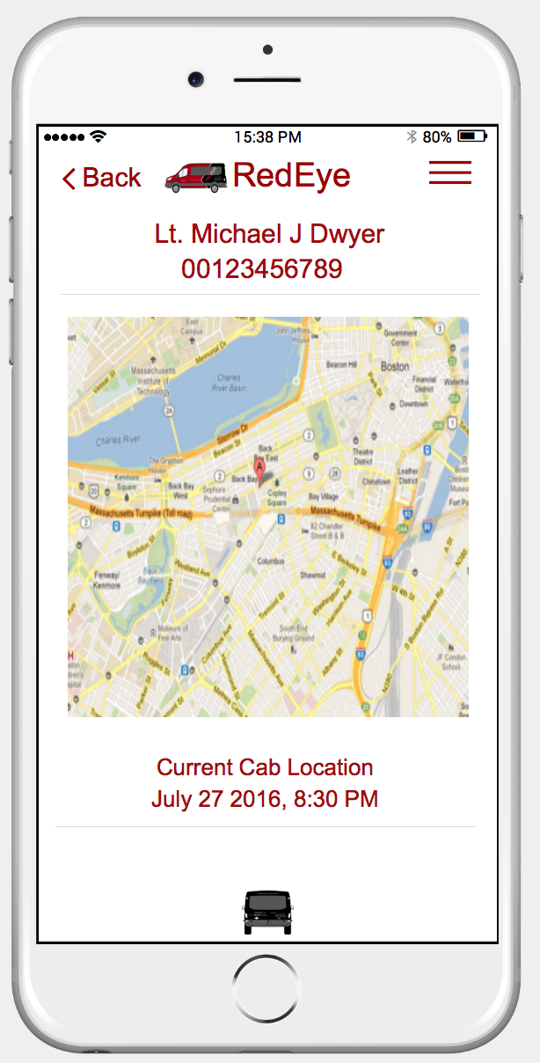
UI – NUPD SUPERVISOR

Slide 16
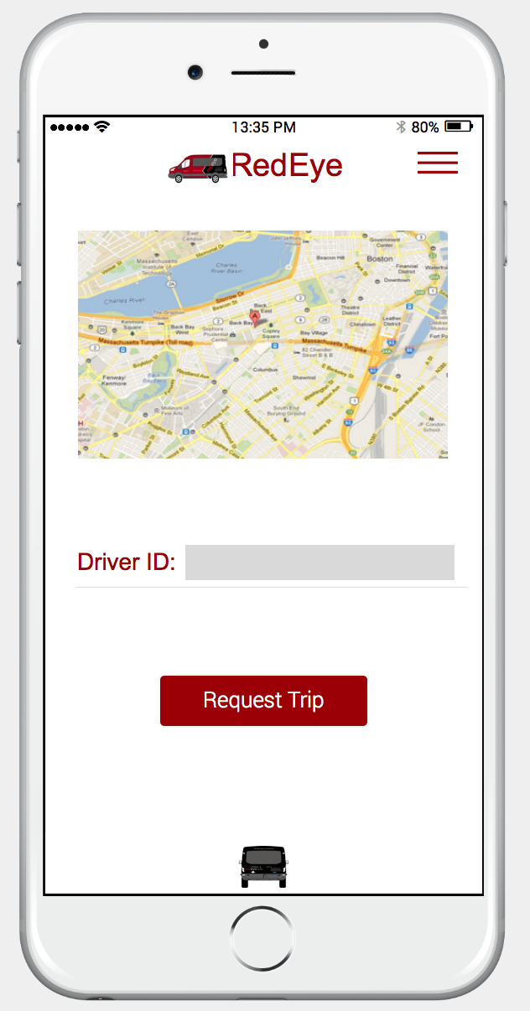
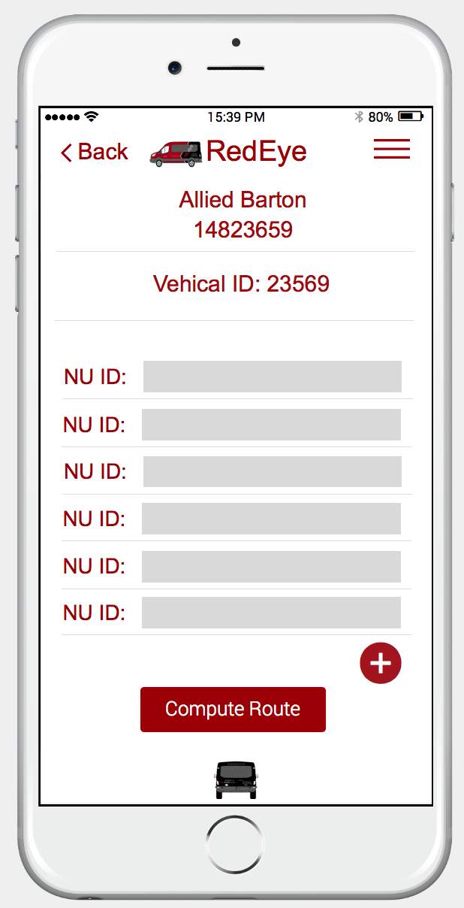
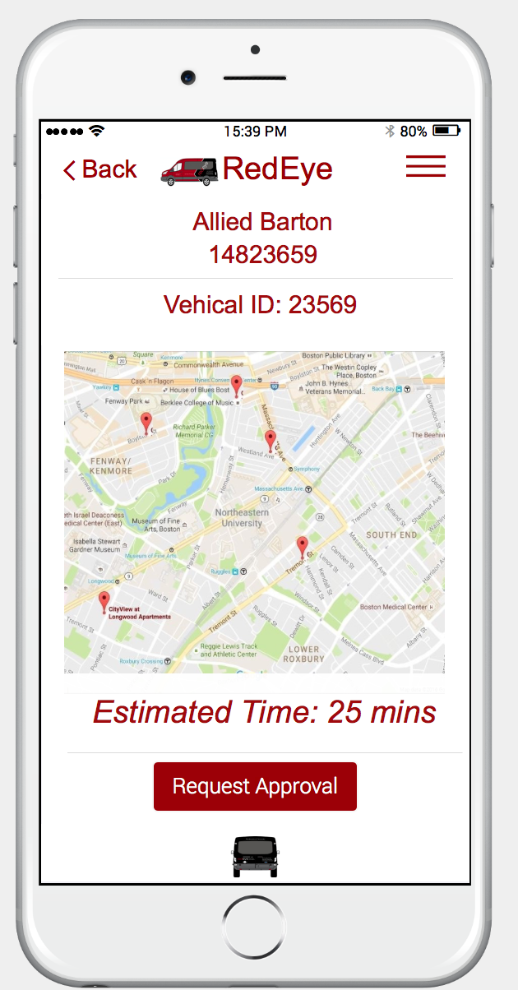
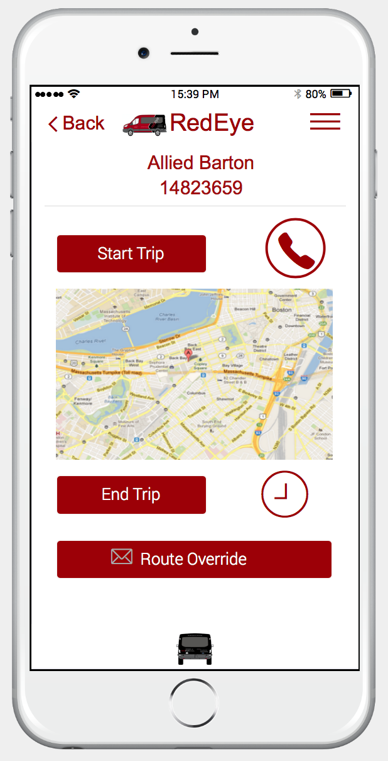
UI– REDEYE DRIVER

Slide 17

UI Prototype : Demo

Slide 18
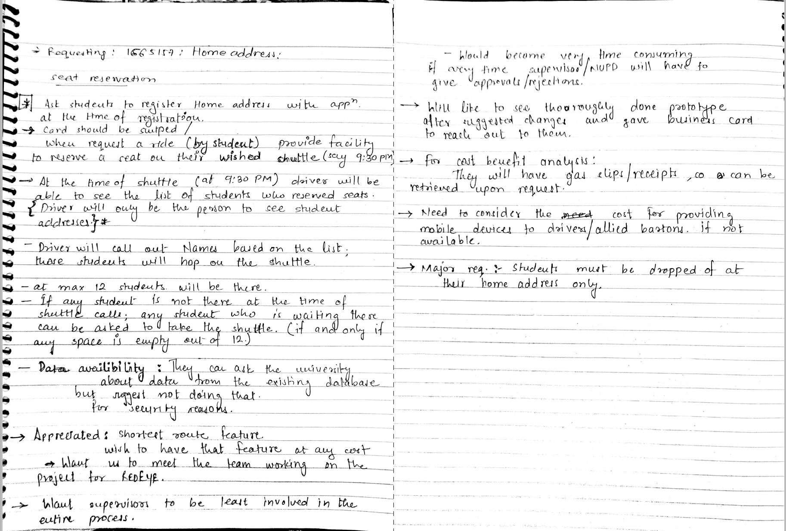

Feedback from customers

Slide 19


Questions ?
Pitched in Idea Club

